Slide 1
Storing Data: Disks and Files
Chapter 9
“Yea, from the table of my memory
I’ll wipe away all trivial fond records.”
-- Shakespeare, Hamlet
Notes:
1
The slides for this text are organized into chapters. This lecture covers Chapter 7.
Chapter 1: Introduction to Database Systems
Chapter 2: The Entity-Relationship Model
Chapter 3: The Relational Model
Chapter 4 (Part A): Relational Algebra
Chapter 4 (Part B): Relational Calculus
Chapter 5: SQL: Queries, Programming, Triggers
Chapter 6: Query-by-Example (QBE)
Chapter 7: Storing Data: Disks and Files
Chapter 8: File Organizations and Indexing
Chapter 9: Tree-Structured Indexing
Chapter 10: Hash-Based Indexing
Chapter 11: External Sorting
Chapter 12 (Part A): Evaluation of Relational Operators
Chapter 12 (Part B): Evaluation of Relational Operators: Other Techniques
Chapter 13: Introduction to Query Optimization
Chapter 14: A Typical Relational Optimizer
Chapter 15: Schema Refinement and Normal Forms
Chapter 16 (Part A): Physical Database Design
Chapter 16 (Part B): Database Tuning
Chapter 17: Security
Chapter 18: Transaction Management Overview
Chapter 19: Concurrency Control
Chapter 20: Crash Recovery
Chapter 21: Parallel and Distributed Databases
Chapter 22: Internet Databases
Chapter 23: Decision Support
Chapter 24: Data Mining
Chapter 25: Object-Database Systems
Chapter 26: Spatial Data Management
Chapter 27: Deductive Databases
Chapter 28: Additional Topics

Slide 2
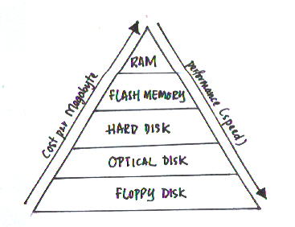
Database Storage hierarchy
Magnetic Tape
Image credits. http://www.doc.ic.ac.uk/~nd/surprise_97/journal/vol2/lpl/

Slide 3
Why Not Store Everything in Main Memory?
Costs too much.
Main memory is volatile. We want data to be saved between runs. (Obviously!)
Typical storage hierarchy:
Main memory (RAM) for currently used data.
Disk for the main database (secondary storage).
Tapes for archiving older versions of the data (tertiary storage).
Notes:
19

Slide 4
Disks and Files
Most DBMS stores information on (“hard”) disks.
This has major implications for DBMS design!
READ: transfer data from disk to main memory (RAM).
WRITE: transfer data from RAM to disk.
Both are high-cost operations, relative to in-memory operations, so must be planned carefully!

Slide 5

Disks
Secondary storage device of choice.
Main advantage over tapes: random access vs. sequential.
Data is stored and retrieved in units called disk blocks or pages.
Unlike RAM, time to retrieve a disk page varies depending upon location on disk.
Therefore, relative placement of pages on disk has major impact on DBMS performance!
Notes:
20

Slide 6
Disk Space Management in a DBMS
Lowest layer of DBMS software manages space on disk.
Higher levels call upon this layer to:
allocate/de-allocate a page
read/write a page
Request for a sequence of pages must be satisfied by allocating the pages sequentially on disk!
Higher levels don’t need to know how this is done, or how free space is managed.
Query Optimization
and Execution
Relational Operators
Files and Access Methods
Buffer Management
Disk Space Management
DB
Notes:
24

Slide 7
Buffer Management in a DBMS
Page Requests from Higher Levels
BUFFER POOL
disk page
free frame
MAIN MEMORY
DISK
choice of frame dictated
by replacement policy
DB
Data must be in RAM for DBMS to operate on it!
Buffer Mgr hides the fact that not all data is in RAM

Slide 8
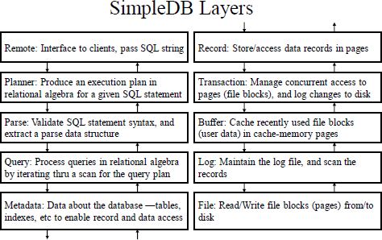

Slide 9
Buffer Management
When a page is brought into the buffer, it is “pinned” by the requestor
The requestor must also unpin a page when it is no longer needed and indicate whether page has been modified (page is dirty )
A dirty bit is used for this.
Page in pool may be requested many times,
a pin count is used for this.
Buffer pool information table contains: <frame#, pageid, pin_count, dirty>
Notes:
6

Slide 10
When a Page is Requested ...
If requested page is not in pool:
Choose a frame for replacement
Only pages with pin count = 0 can be candidates
If frame is dirty, write it to disk
CC & recovery may entail additional I/O when a frame is chosen for replacement. (Write-Ahead Log protocol; more later.)
Read requested page into chosen frame
Pin the page and return its address.
If requests can be predicted (e.g., sequential scans)
pages can be pre-fetched several pages at a time!
Notes:
5

Slide 11
Buffer Replacement Policy
Frame is chosen for replacement by a replacement policy:
Least-recently-used (LRU), Clock, MRU etc.
Policy can have big impact on # of I/O’s; depends on the access pattern.
Notes:
7

Slide 12
LRU Replacement Policy
Least Recently Used (LRU)
for each page in buffer pool, keep track of time when last unpinned
replace the frame which has the oldest (earliest) time
Least likely to be accessed again
Very common policy: intuitive and simple
Works well for repeated accesses to popular pages
Problems?
Will see later

Slide 13
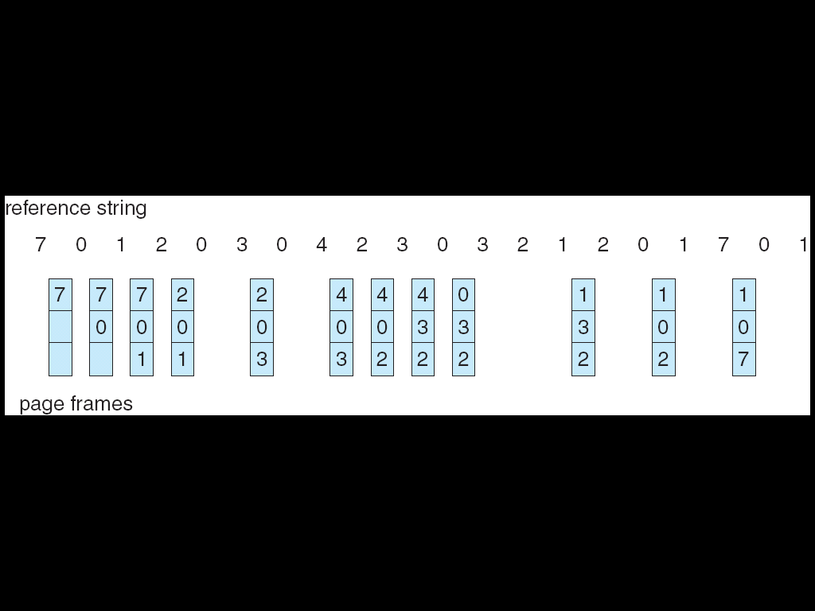
LRU Page Replacement (Ignoring pin/unpin!!!)
1
1
1
4
4
2
2
2
5
5
3
3
6

Slide 14
More realistic – with pin/unpin.
pin(blk1); pin(blk2); pin(blk3); pin(blk4); unpin(blk4); pin(blk5); unpin(blk2); …
Note: Many of our examples abstract from the interleaving of pin/unpin calls
i.e. so we can assume unpin is called right after pin in those examples
Which blk is least recently used at end here?

Slide 15
More realistic request sequence (contd).
What about?
pin(blk1); pin(blk2); pin(blk3); pin(blk4); unpin(blk4); pin(blk1); unpin(blk1); pin(blk5); unpin(blk2); …
What is pincount for blk1 at this point?
What is pincount for blk4 at this point?
Which is least recently used at end of sequence?

Slide 16
What about here
What about?
pin(blk1); pin(blk2); pin(blk3); pin(blk4); unpin(blk4); pin(blk1); unpin(blk1); pin(blk4); unpin(blk2); …
Which is least recently used at end of sequence?

Slide 17
Issue with LRU
Reference string: 1, 2, 3, 4, 5, 1, 2, 3, 4
1
2
3
1
5
5
2
2
1
3
3
2
4
4
4
LRU + repeated sequential scans → Problem: Sequential flooding .
# buffer frames < # pages in reference pattern means each page request causes an I/O.
MRU better in this scenario?

Slide 18
LRU Implementations
Counter implementation:
Every page entry has a counter;
every time a page is referenced through this entry, copy the clock (logical time) into the counter.
When a page/frame needs to be changed, look at the counters to determine which are to change.
May have to search all frames
Stack implementation – keep a stack of page numbers in a double link form:
Page referenced:
move it to the top
requires 6 pointers to be changed
No search for replacement.

Slide 19
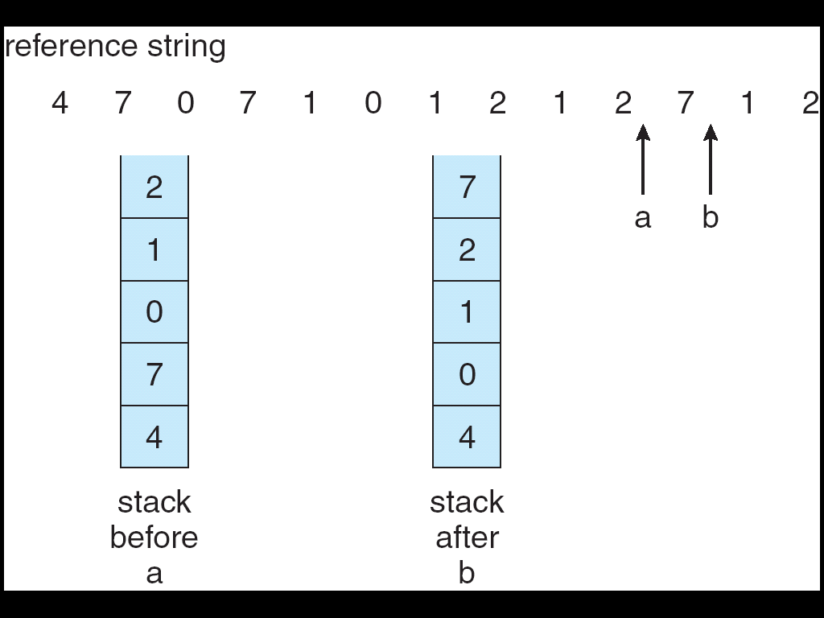
Use of a stack to implement LRU
Stack implementation – keep a stack of page numbers in a double link form:
Page referenced:
move it to the top
No search for replacement – always take the bottom one.

Slide 20
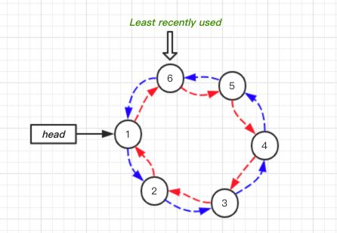
LRU (Doubly Linked List Stack Implementation)
requires a fixed number of pointers to be changed (5, 6, 7)
Request for 5 needs to move it to “top” (currently 1’s position)
Do:
head to 5
connect 5 to 1
connect 6 to 4

Slide 21
“Clock” (Second Chance) Replacement Policy
A(1)
An approximation of LRU
Arrange frames into a cycle, store one reference bit per frame
Can think of this as the 2nd chance bit
When pin count reduces to 0, turn on ref. bit
When replacement necessary do for each page in cycle { if (pincount == 0 && ref bit is on) turn off ref bit; else if (pincount == 0 && ref bit is off) choose this page for replacement; } until a page is chosen;
B(p)
D(1)
C(1)
Questions:
How like LRU?
Problems?

Slide 22
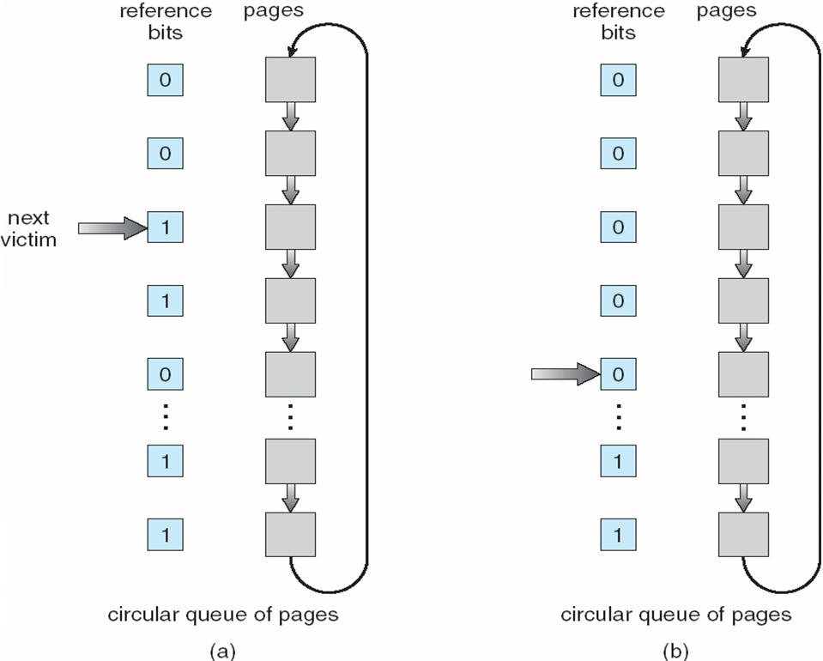
Clock Page-Replacement Algorithm

Slide 23
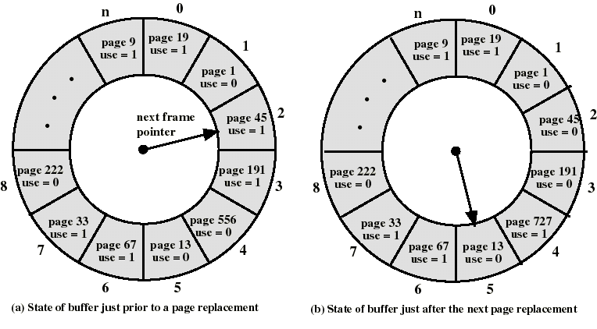
The Clock Policy: Another Example
Pin count is not represented in this figure but is a factor
Note: Pin count would
have to have been 0 for replacement to happen

Slide 24
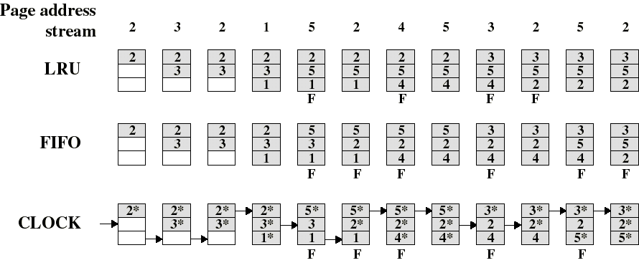
Side-by-Side Comparison of Some Replacement Policies (OS Version of Algorithms)
Note that these are based on the version of algorithms used by OS (not exactly ours)
But suffice to illustrate that different replacement policies have different performances on same access patterns

Slide 25
DBMS vs. OS File System
Why not let OS handle database physical and virtual memory management?
Virtual memory/Buffer management in DBMS requires ability to:
pin a page in buffer pool, force a page to disk (important for implementing CC & recovery),
adjust replacement policy, and pre-fetch pages based on access patterns in typical DB operations.
File system issues:
Differences in OS support: portability issues
Some limitations, e.g., files can’t span disks.
Notes:
8

Slide 26
File Management

Slide 27
Components of a Disk
Spindle
Disk head
Tracks
The platters spin (say, 90rps).
The arm assembly is moved in or out to position a head on a desired track. Tracks under heads make a cylinder (imaginary!).
Sector
Arm movement
Platters
Only one head reads/writes at any one time.
Arm assembly
Block size is a multiple of sector size (which is fixed).
Notes:
21

Slide 28
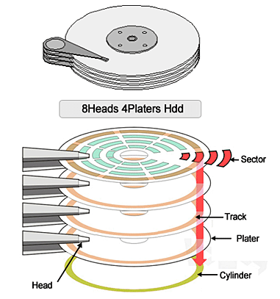
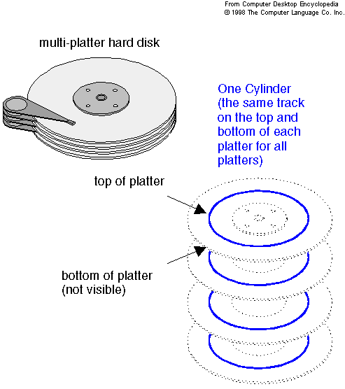
Slide credits: http://hdd-data.jp/hdd-recovery/hdd-organization.html

Slide 29
Accessing a Disk Page
Time to access (read/write) a disk block:
seek time (moving arms to position disk head on track)
rotational delay (waiting for block to rotate under head)
transfer time (actually moving data to/from disk surface)
Seek time and rotational delay dominate.
Seek time varies from about 1 to 20msec
Rotational delay varies from 0 to 10msec
Transfer rate is about 1msec per 4KB page
Key to lower I/O cost: reduce seek/rotation delays!
Notes:
22

Slide 30
Arranging Pages on Disk
Blocks in a file should be arranged sequentially on disk (by `next’), to minimize seek and rotational delay
`Next’ block concept:
blocks on same track, followed by
blocks on same cylinder, followed by
blocks on adjacent cylinder
For a sequential scan, pre-fetching several pages at a time is a big win!
Notes:
23

Slide 31
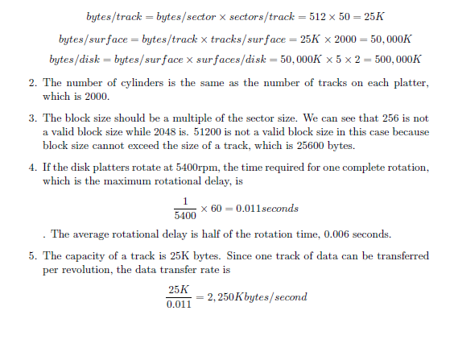
Consider a disk with a sector size of 512 bytes,
50 sectors per track, 2000 tracks per surface,
five double-sided platters, and
average seek time of 10 msec.
1. What is the capacity of a track in bytes? each surface? the disk?
2. How many cylinders does the disk have?
3. Give examples of valid block sizes. Is 256 bytes a valid block size? 2048? 51200?

Slide 32
4. If the disk platters rotate at 5400 rpm (revolutions per minute),
what is the maximum rotational delay?

Slide 33
5. If one track of data can be transferred per revolution, what is the transfer rate in Kbytes/sec

Slide 34
Consider previous disk specifications plus
(i) a block size of 1024 bytes is chosen.
(ii) a file containing 100,000 records of 100 bytes each is to be stored on such a disk and that no record is allowed to span two blocks.
1. How many records fit onto a block?
1024/100 = 10
2. How many blocks are required to store the entire file?
10,000blks
3. How many records of 100 bytes each can be stored using this disk?
10* 25 * 2000 * 10 = 5M records

Slide 35
4. If pages are stored sequentially on disk, with page 1 on block 1 of track 1,
(i) what page is stored on block 1 of track 1 on the next disk surface?
page 26
(ii) what if the disk were capable of reading and writing from all heads in parallel?
page 2
how many surfaces are needed to store entire file ? All 10 surfaces

Slide 36
5. Time for reading a file containing
100,000 records of 100 bytes each sequentially?
40 cylinders (10,000blks) i.e. 40 seeks = 400ms
40 * 10 max rotational delays i.e. 400* 11ms = 4400ms
Total = 400 + 4400 = 4800ms or 4.8s
Sequential reading of some blocks (not full track)
Divide full rotation by appropriate fraction e.g 5 blks is 20%
additional avg rd because need to rotate to first in sequence

Slide 37
5. If the disk were capable of reading/writing from all heads in parallel (with data was arranged optimally)?
40 * 11ms = 440ms (#rds reduced by a fraction of 10)
= 400 + 440 = 840ms or .84s

Slide 38
Additional possible disk specifications to consider
Inter block gaps (gradiance homework)
Total capacity vs Useful capacity (excluding gaps)
Rotation time includes going over the gaps too. Need to account for space covered by gaps

Slide 39
Time required to read the all blocks in file but in random order?
Assume that each block request incurs the average seek time and rotational delay.
Each of the 10K blocks will incur a separate seek, rotational delay and transfer time.
Time for 1 blk = 10ms + 0.006s + transfer time for 1 blk
Transfer time for 1blk @ 2250Kb/sec transfer rate is
1000ms/2250Kb = 0.4444ms
Time for 1blk = 10ms + 6ms + 0.44ms = 16.44ms
Time for 10K blks is 16.44ms * 10,000 = 164.4secs.

Slide 40
Files of Records
Page or block is OK when doing I/O, but higher levels of DBMS operate on records, and files of records.
FILE: A collection of pages, each containing a collection of records. Must support:
insert/delete/modify record
read a particular record (specified using record id)
scan all records (possibly with some conditions on the records to be retrieved)
Notes:
13

Slide 41
Unordered (Heap) Files
Simplest file structure contains records in no particular order.
As file grows and shrinks, disk pages are allocated and de-allocated.
To support record level operations, we must:
keep track of the pages in a file
keep track of free space on pages
keep track of the records on a page
There are many alternatives for keeping track of this.
Notes:
14

Slide 42
Heap File Implemented as a List
Data
Page
Data
Page
Data
Page
Full Pages
Header
Page
Data
Page
Data
Page
Data
Page
Pages with
Free Space
The header page id and Heap file name must be stored some place.
Each page contains 2 `pointers’ plus data
Newly allocated page added to free page list
Inserting a record may mean scanning the free page list to find one with enough space
Notes:
15

Slide 43
Heap File Using a Page Directory
Data
Page 1
Header
Page
Data
Page 2
Data
Page N
DIRECTORY
The entry for a page can include the number of free bytes on the page.
The directory is a collection of pages; linked list implementation is just one alternative.
Much smaller than linked list of all HF pages!
Notes:
16

Slide 44
Page Formats: Fixed Length Records
Slot 1
Slot 1
Slot 2
Slot 2
. . .
Free
Space
. . .
Slot N
Slot N
Slot M
N
1
. . .
0
1
1
M
number
of records
M ... 3 2 1
number
of slots
PACKED
UNPACKED, BITMAP
Record id = <page id, slot #>.
For packed format, moving records for free space management changes rid; may not be acceptable.
Notes:
11

Slide 45
Page Formats: Variable Length Records
Rid = (i,N)
Page i
Rid = (i,2)
Rid = (i,1)
20
16
24
N
Pointer
to start
of free
space
N . . . 2 1
# slots
SLOT DIRECTORY
Can move records on page without changing rid; so, attractive for fixed-length records too.
Notes:
12

Slide 46
Record Formats: Fixed Length
F1
F2
F3
F4
L1
L2
L3
L4
Base address (B)
Address = B+L1+L2
Information about field types same for all records in a file; stored in system catalogs.
Finding i’th field –offset can be calculated based given size of fields.
Space wasted for fields with null values
Notes:
9

Slide 47
Record Formats: Variable Length
Two alternative formats (# fields is fixed):
F1 F2 F3 F4
4
$
$
$
$
Fields Delimited by Special Symbols
Field
Count
F1 F2 F3 F4
Array of Field Offsets
Second offers direct access to i’th field, efficient storage
of nulls (special don’t know value); small directory overhead.
Notes:
10

Slide 48
DB File and Memory Management Implementation Perspective: SimpleDB – A case study
**** Very recent release and new edition of book with minor implementation changes
Will highlight as we go along.

Slide 49
Another Look at SimpleDB

Slide 50
Simpledb.file package
Block level access – full control, more complex
OS file level – simpler, but more constrained by OS limits e.g. file size, db files spanning disks etc
SimpleDB uses a compromise between block and file level access for file management
Store data in one or more OS files
DB “disk” accessed using logical “file blocks”
OS maps logical to physical blocks (using seek calls)
simpledb.file package exposes 3 classes: BlockId, Page, FileMgr

Slide 51
File Manager API
FileMgr interfaces the DBMS to the OS
Tables, indexes, log, and catalogs are stored as OS files
File blocks are read into pages and values manipulated
Pages are written to disk
BlockId
public BlockId(String filename, int blocknum)
public String filename()
public int number()
FileMgr
public FileMgr(String dbDirectory, int blocksize)
public void write(BlockId blk, Page p)
public void read(BlockId blk, Page p)
public BlockId append(String filename)
public boolean isNew()
public int length(String filename)
public int blockSize()
Page
public Page(int blocksize) //buffMgr
public Page contents(byte[] b) //logMgr
public int getInt(int offset)
public boolean getBytes(int offset)
public void getString(int offset)
public void setString(int offset, String val)
public void setBytes(int offset, byte[] val)
public void setInt(int offset, int val))

Slide 52
FileMgr Class
Single FileMgr object at server initialization handles interaction with OS and provides block level access to database files
Primary job is to read, write and append block-sized disk blocks
Name of database and block size as constructor parameters. DB folder is created
Files (Java RandomAccessFile objects) are opened (rws) for reading and synchronous writing
Keeps a mapping of open filenames and their Java FileChannel
Modified FileMgr should be unit tested using a test driver

Slide 53
BlockId and Page Classes
BlockId
Identifies specific block by filename and logical block#
Page
Holds content of a disk block
Created from memory from OS I/O buffer (bufferMgr) or memory from Java array (LogMgr)
Currently holds 3 types of values: integer, string, byte blobs
Corresponding methods to get and set values

Slide 54
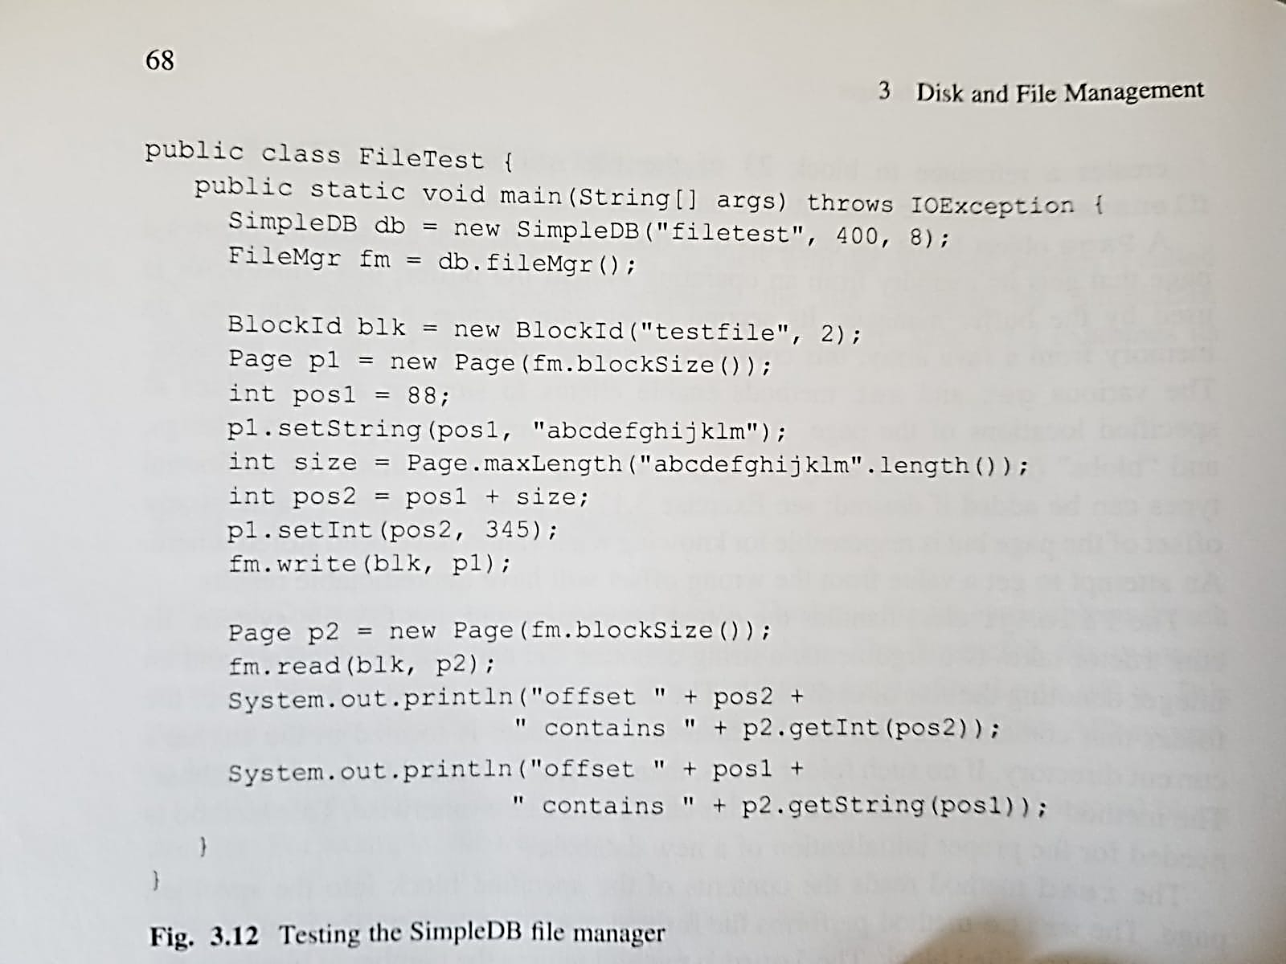
Example SimpleDB File Package Program

Slide 55
SimpleDB Buffer Manager API
BufferMgr
public BufferMgr(FileMgr f, LogMgr lm, int numbuffs
public Buffer pin(BlockId blk)
public void unpin(Buffer buff)
public int available()
public void flushAll(int txnum)
Buffer
public Buffer(FileMgr f, LogMgr lm, int numbuffs
public Page contents()
public BlockId block()
public boolean isPinned()
public void setModified(int txnum, int lsn)
public int modifyingTx()
void assignToBlock(BlockId b)
void pin()
void unpin()
void flush()

Slide 56
Class BufferMgr
BufferMgr manages the client wait list
pin implements a wait and throws an exception if the client waits too long (deadlock avoidance)
First sees if block already pinned on some page
If not, looks for available buffer based on policy
If found, call buffer’s methods to assignblock and pin
Otherwise, put on waitlist
unpin makes a call to notifyAll() to restart waiting clients

Slide 57
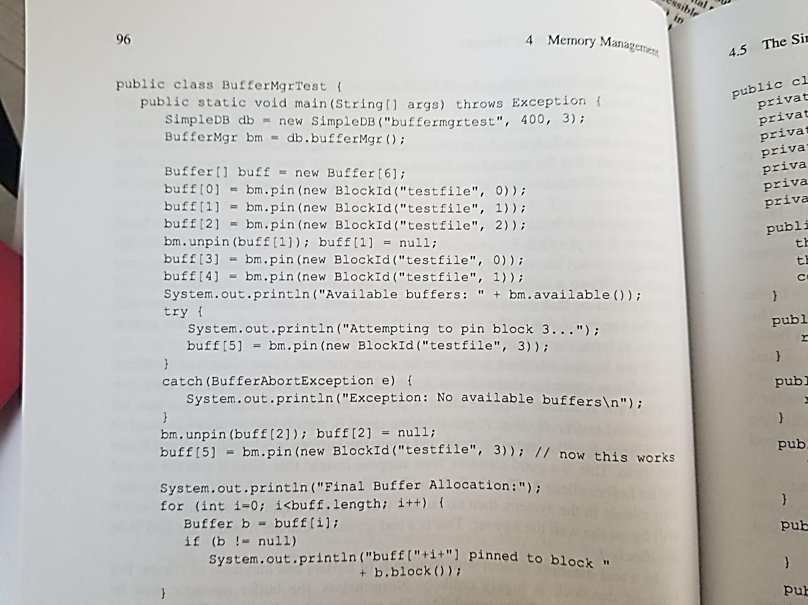
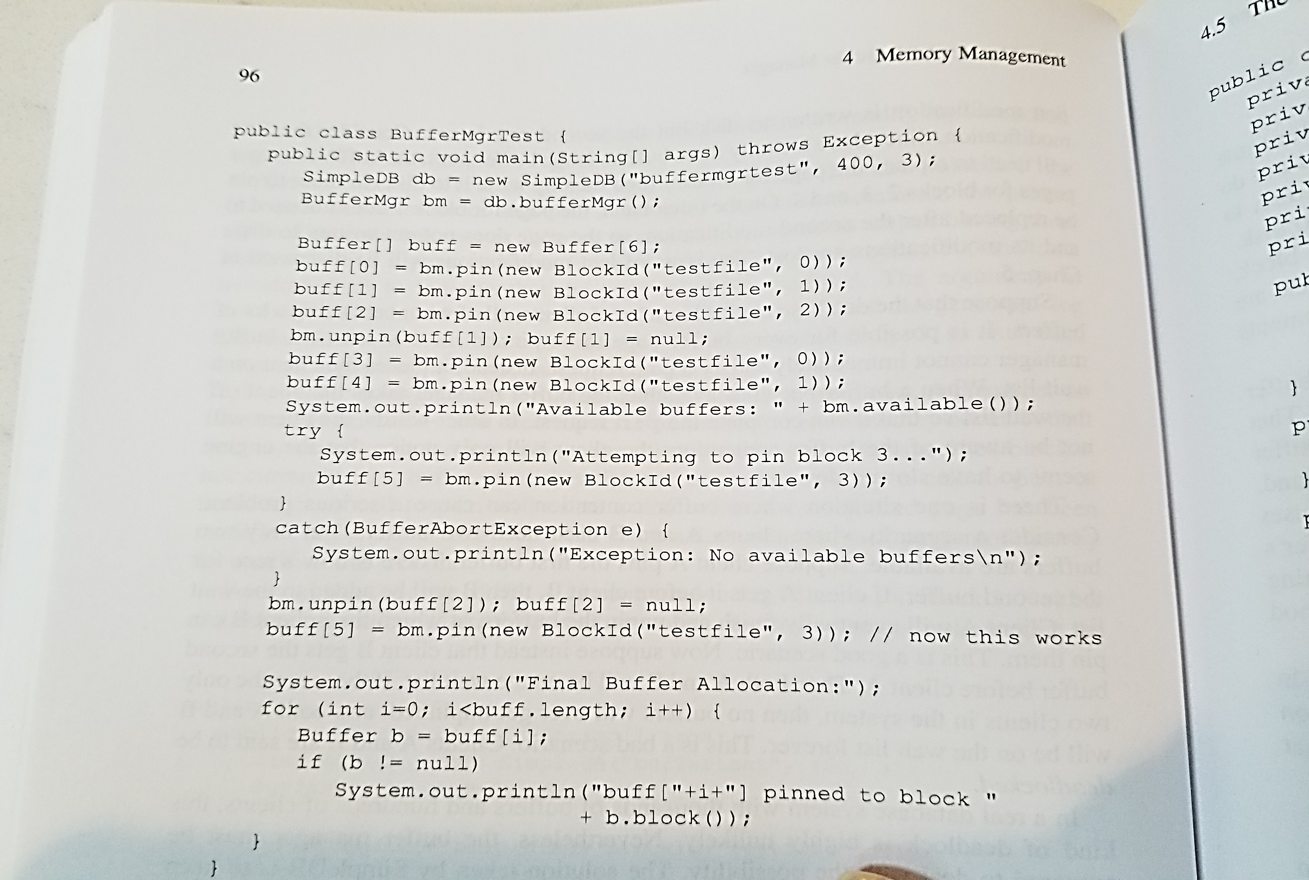
Example Program BufferMgr Package

Slide 58
Avoiding Deadlocks
If buffer unavailable, requesting client thread is placed on a wait list
Normally, some other client will unpin a buffer and the waiting client can proceed
However, deadlock can occur if two clients A and B each need two buffers:
A is granted 1st buffer, and B the 2nd buffer
Subsequent requests, A and B will be placed on a wait list, each waiting forever for each other
To avoid deadlock, SimpleDB tracks client wait time (e.g. 10 sec), then throws an exception
The JDBC client catches the BufferAbortException rollbacks the transactions, then restarts it

Slide 59
SimpleDB Buffer
Private variables track status of the associated page
Reference to block assigned to page
Number of times it is pinned
Integer indicating if page was modified (-1 = none)
Log information – LSN of most recent log record that modified page
Methods
flush() ensures the page has the same values as the disk block
First calls LogMgr.flush to flush log record before flushing to disk (WAL protocol)

Slide 60
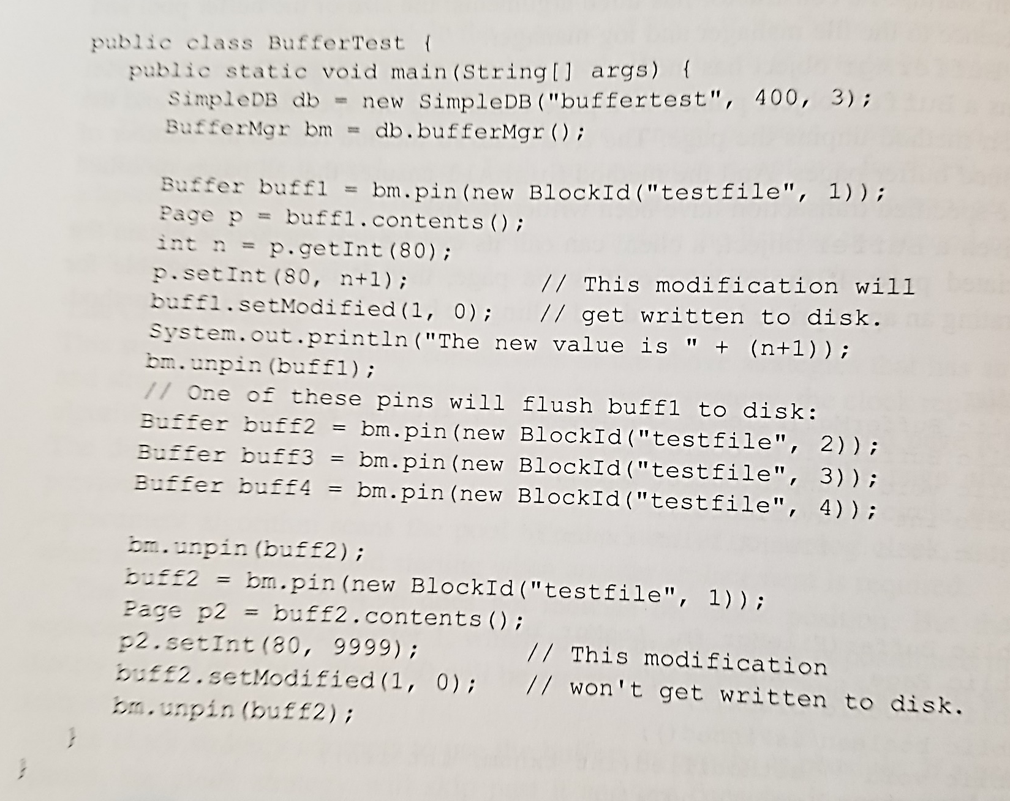
Example Program Buffer class
Buffer manager hides if and when disk accesses happen from client

Slide 61
Project 2 (to be posted today)
Setup SimpleDB and do preparatory exercise

Slide 62
Summary
Disks provide cheap, non-volatile storage.
Random access, but cost depends on location of page on disk; important to arrange data sequentially to minimize seek and rotation delays.
Buffer manager brings pages into RAM.
Page stays in RAM until released by requestor.
Written to disk when frame chosen for replacement (which is sometime after requestor releases the page).
Choice of frame to replace based on replacement policy.
Tries to pre-fetch several pages at a time.
Notes:
20

Slide 63
Summary (Contd.)
DBMS vs. OS File Support
DBMS needs features not found in many OS’s, e.g., forcing a page to disk, controlling the order of page writes to disk, files spanning disks, ability to control pre-fetching and page replacement policy based on predictable access patterns, etc.
Variable length record format with field offset directory offers support for direct access to i’th field and null values.
Slotted page format supports variable length records and allows records to move on page.
Notes:
21

Slide 64
Summary (Contd.)
File layer keeps track of pages in a file, and supports abstraction of a collection of records.
Pages with free space identified using linked list or directory structure (similar to how pages in file are kept track of).
Indexes support efficient retrieval of records based on the values in some fields.
Catalog relations store information about relations, indexes and views. (Information that is common to all records in a given collection.)
Notes:
22

